Slide 1

Pattern Classification
All materials in these slides were taken from
Pattern Classification (2nd ed) by R. O. Duda, P. E. Hart and D. G. Stork, John Wiley & Sons, 2000 with the permission of the authors and the publisher

Slide 2
Chapter 3 (Part 3):
Maximum-Likelihood and Bayesian Parameter Estimation (Section 3.10)
Hidden Markov Model: Extension of
Markov Chains

Slide 3
Hidden Markov Model (HMM)
  Interaction of the visible states with the hidden states
  ∑b_{jk}= 1 for all j where b_{jk}=P(V_{k}(t) | ω_{j}(t)).
  3 problems are associated with this model
    The evaluation problem
    The decoding problem
    The learning problem

Slide 4
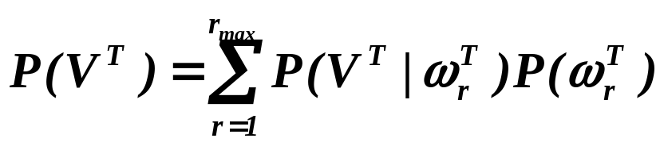
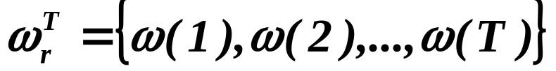
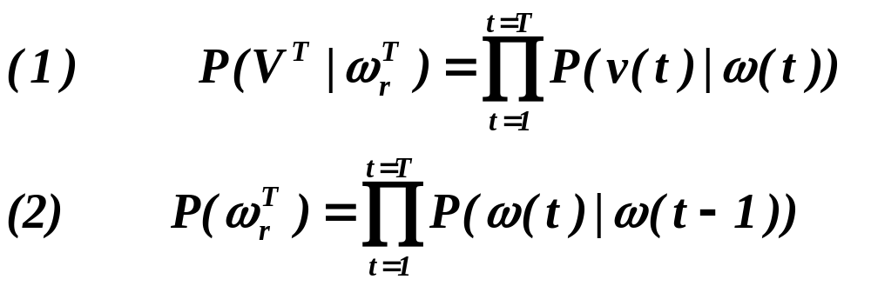
    The evaluation problem
    It is the probability that the model produces a sequence V^{T} of visible states. It is:
    where each r indexes a particular sequence
    of T hidden states.

Slide 5
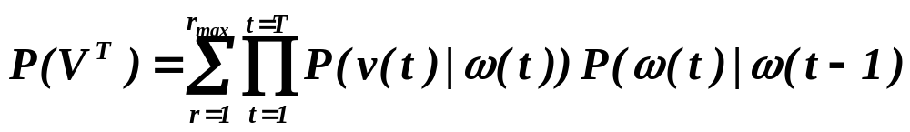
    Using equations (1) and (2), we can write:
    Interpretation: The probability that we observe the particular sequence of T visible states V^{T} is equal to the sum over all r_{max} possible sequences of hidden states of the conditional probability that the system has made a particular transition multiplied by the probability that it then emitted the visible symbol in our target sequence.
    Example: Let ω₁, ω₂, ω₃ be the hidden states; v₁, v₂, v₃ be the visible states
    and V³ = {v₁, v₂, v₃} is the sequence of visible states
    P({v₁, v₂, v₃}) = P(ω₁).P(v₁ | ω₁).P(ω₂ | ω₁).P(v₂ | ω₂).P(ω₃ | ω₂).P(v₃ | ω₃)
    +…+ (possible terms in the sum= all possible (3³= 27) cases !)

Slide 6
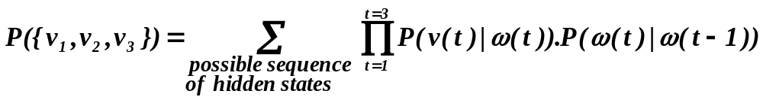
v₁
v₂
v₃
    First possibility:
    Second Possibility:
    P({v₁, v₂, v₃}) = P(ω₂).P(v₁ | ω₂).P(ω₃ | ω₂).P(v₂ | ω₃).P(ω₁ | ω₃).P(v₃ | ω₁) + …+
    Therefore:
ω₁
(t = 1)
ω₂
(t = 2)
ω₃
(t = 3)
v₁
v₂
v₃
ω₂
(t = 1)
ω₃
(t = 2)
ω₁
(t = 3)

Slide 7
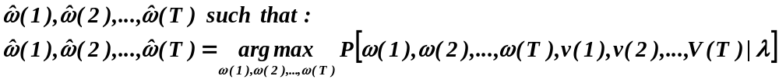
    The decoding problem (optimal state sequence)
    Given a sequence of visible states V^{T}, the decoding problem is to find the most probable sequence of hidden states.
    This problem can be expressed mathematically as:
    find the single “best” state sequence (hidden states)
Note that the summation disappeared, since we want to find
Only one unique best case !

Slide 8
    Where: λ = [π,A,B]
    π = P(ω(1) = ω) (initial state probability)
    A = a_{ij} = P(ω(t+1) = j | ω(t) = i)
    B = b_{jk} = P(v(t) = k | ω(t) = j)
    In the preceding example, this computation corresponds to the selection of the best path amongst:
    {ω₁(t = 1),ω₂(t = 2),ω₃(t = 3)}, {ω₂(t = 1),ω₃(t = 2),ω₁(t = 3)}
    {ω₃(t = 1),ω₁(t = 2),ω₂(t = 3)}, {ω₃(t = 1),ω₂(t = 2),ω₁(t = 3)}
    {ω₂(t = 1),ω₁(t = 2),ω₃(t = 3)}

Slide 9
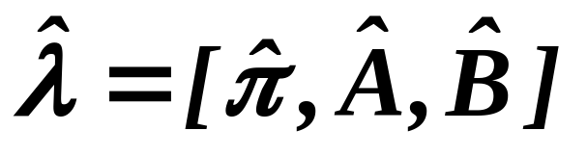
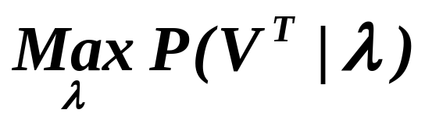
    The learning problem (parameter estimation)
    This third problem consists of determining a method to adjust the model parameters λ = [π,A,B] to satisfy a certain optimization criterion. We need to find the best model
    Such that to maximize the probability of the observation sequence:
    We use an iterative procedure such as Baum-Welch or Gradient to find this local optimum

